Slide 1
Welcome To York Code Dojo
Yorkdevelopers.org
@yorkdevelopers
@yorkcodedojo

Slide 2
Agenda
Quick Introduction
Explain the problem
Work in pairs till 8.45pm
Opportunity to show off solutions
Pub about 9pm

Slide 3
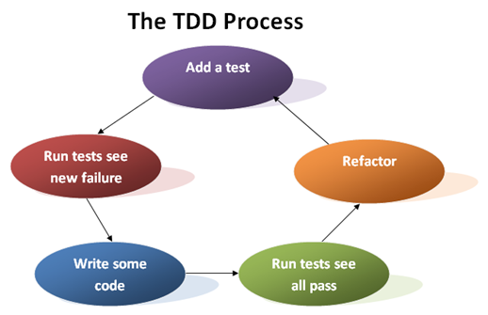
Notes:
Who knows what TDD is?
Who has done TDD before?
Normally you write your code – then test it
With TDD you write your tests first, then your code
Why?
Tests become the specification or documentation for your code
You write code which is testable
You have a very high test coverage %
It’s a three stage process
Red - Write a test (which fails)
Green - Write the minimum amount to pass your test. This stage should be fast. If it’s taking a long time, then maybe your test is making too big a leap
Refactor (tidy up your code)
Check your tests still pass

Slide 4
Demo
Count the number of words in a string
Two visual studio project – class library and unit tests

Slide 5
Word Wrap
You write a class called Wrapper, that has a function named wrap that takes two arguments, (a string), and the column width (a number.)
The function returns the string, but with line breaks inserted at just the right places to make sure that no line is longer than the column number.
You try to break lines at word boundaries.
If it doubt try to replicate the behaviour of your text editor (notepad etc)

Slide 6
Tonight’s Problem
Aim
Technique
Word wrap
Work in pairs
Notes:
Aim - Trying TDD is more important that solving the problem
Technique - Don’t think about how you are going to solve it.
Requirements - If in doubt look at how notepad works
Pairs - Work in pairs, ping-pong. One writes the test, the other writes the code. Then swap
What if the word is hypenated

Slide 7
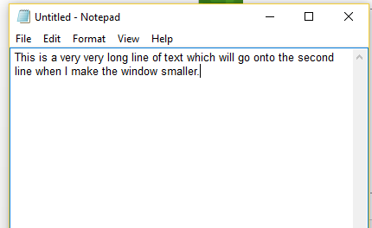
Code

Slide 8
TDD - Views
Pros and Cons
Notes:
Some people use it 100% of the time, and wouldn’t write a line of production code with first writing a test
Other people don’t like the way TDD drives the design of their classes

